Slide 1
Dominance by Stability: A Framework for Top k Dominating Query On Incomplete Data
2nd International Conference on Big Data, IoT and Machine Learning (BIM 2023)
PAPER ID: 361
Faruk Hossen, K.M Azharul Hasan

Slide 2
Introduction
Top-k dominance (TKD) finds the most dominating objects in a dataset.
TKD becomes an important decision making tool for many organizations
To dominate another record, a record must dominate another by all dataset attributes.
TKD fails to deal with varying ratings in a dataset where those varying ratings can be fabricated.

Slide 3
Problem Statement
The top-k dominating (TKD) query is a method for discovering most prominent k items from a large dataset.
For example- A user wants top k hotels in a city to reserve room in it to get better opportunity.
Let the suggested top item’s ratings are 2, 5, 1, 5, 2, 4, 3.
User becomes confused because ratings are varying where some are suggesting good and where some are suggesting bad.
Good ratings can be fake or from hotel authority.
In order to deal with the varying ratings in a dataset, a new technique of TKD is needed that is top-k dominance by stability.

Slide 4
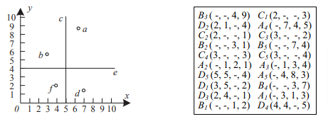
Related Work
TKD on Incomplete Data
Miao et al. proposed TKD method on incomplete dataset[1].
Skyline and upper bound strategies are employed in a TKD to minimize the candidate pool.
The method is ineffective when the dataset and target data are large because there are so many comparisons.

Slide 5
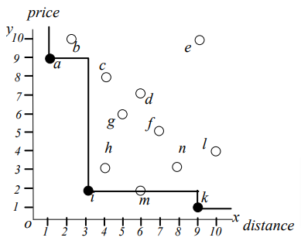
Related Work(Continue…)
Skyline Query
Papadias et al. proposed top-k dominating queries as a version on skyline queries, which carry out closest neighbor searching on a typical data set using R-tree indexing[2].
Skyline query returns the objects that cannot be dominated by any other objects.

Slide 6
Related Work(Continue…)
TKD on Massive Data
Han et al. suggested a method that generates top-k dominant results on enormous data by using low-cost sorted lists for each attribute[3].
A novel algorithm is proposed to utilize sorted lists built for each attribute with low cost to return top-k dominating result on massive data efficiently.
The algorithm can be divided into two phases: growing phase and shrinking phase.

Slide 7
Research Questions:
What is top-k dominance by stability(TKDS)?
How does TKDS do query processing?
What data structure is utilized in this study?
How does TKDS perform?

Slide 8
Objectives
Followings are the objectives of the study
Develop a TKD method to deal with varying dataset
Efficient top-k query processing using efficient data structure.
Efficient way of TKD score computation
Efficient algorithm named as top-k dominance by stability(TKDS) to deal with varying dataset.

Slide 9
Outcomes and Impacts
Effective query processing technique for varying dataset.
Producing less duplicate recommendation.
Producing top-k recommendation within short time.

Slide 10
Methodology
Incomplete Dataset
Creating Data Bucket
Removing records where the mean falls below a certain threshold
Calculating each record's stability using the standard deviation
Returning k records from Dominating CDL
Constructing Dominating CDL extracting k records from each CDL
Creating a CDL for every data bucket

Slide 11
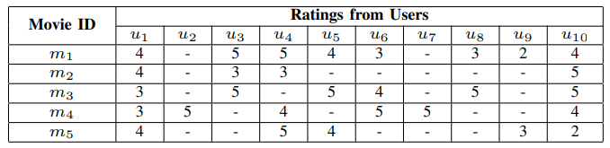
Methodology
Dataset
Movie Lens dataset which is incomplete
Figure above shows the dataset where
m₁ to m₅ are movie ID
u₁ to u₁₀ are ratings from users
'-' indicates the missing values in that dimension

Slide 12
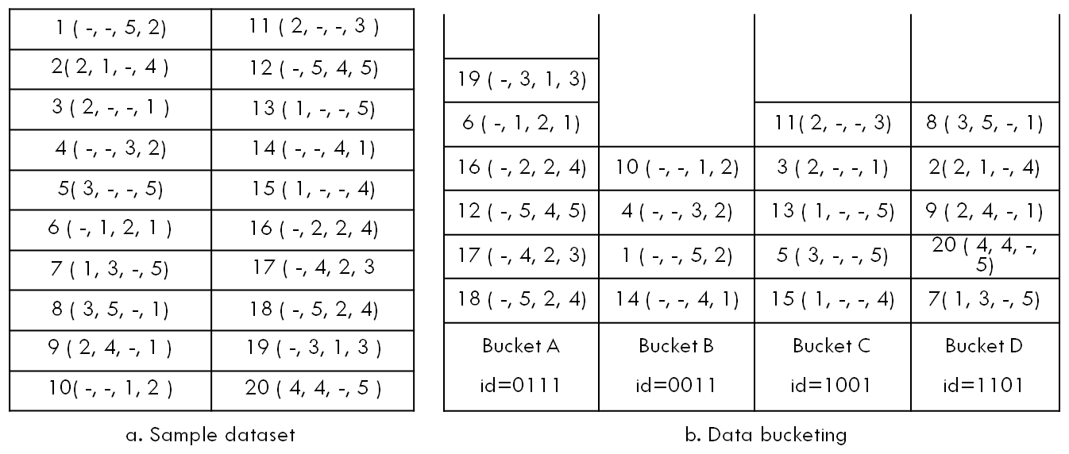
Methodology
Bucketing
Records having same amount of missing values at the same position are put in same data bucket.
Bucket id is produced by assigning 0 and 1 to absence and presence attributes.

Slide 13
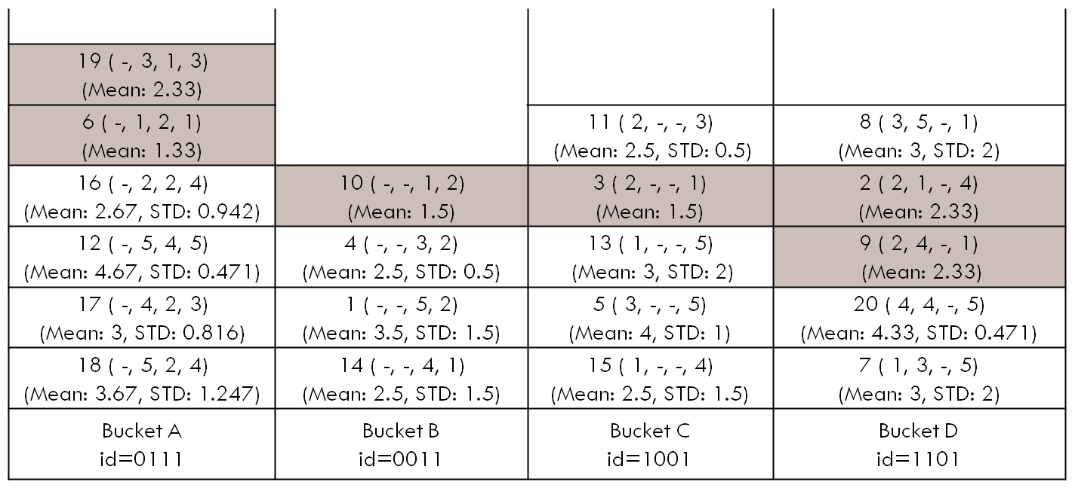
Methodology
Then Records are removed those have mean less than threshold.
Shaded records are removed in the figure.

Slide 14
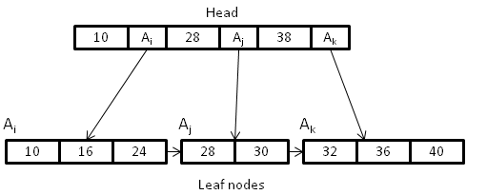
Methodology
Compressed Data List(CDL)
Compressed Data List (CDL) is data structure that is a variant of B+ tree to get sorted sequence [4]
Key-pointer pairs <K, P> form CDL's first level.
The second floor's entrance is on the first level. A node in the second level has keys and pointer.
The following second-level node is pointed to by the pointer of previous node.
The CDL's head and leaf nodes are the first and second levels, respectively.
The leaf node can store maximum of β keys.
Keys stored in a node pointed by a head are greater than or equal to head.
Figure above shows the CDL after inserting the keys 10, 16, 28, 32, 40, 24, 30, 36 where β = 3.

Slide 15

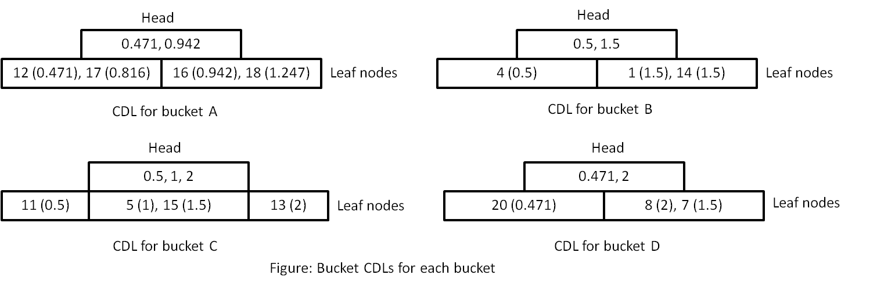
Methodology
Bucket CDL
Every bucket is implemented with CDL is bucket CDL.
Here key is <id, score> where score is stability value.
Stability is computed as

Slide 16
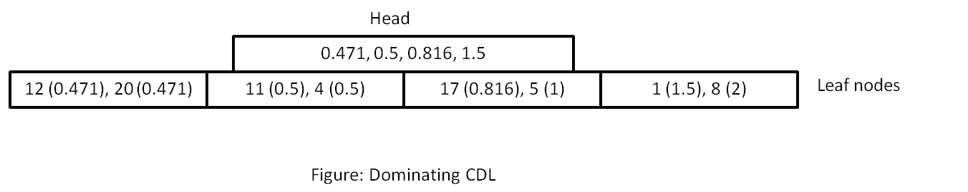
Methodology
Dominating CDL
Another CDL is created taking k records from each bucket CDL is dominating CDL.
Finally k records extracted from dominating CDL as top k records.

Slide 17
Experimental Results
Proposed dominance by stability is contrasted with
Extended Skyband based Algorithm (ESB)
Exhaustive Pairwise Comparison (EPC)
Performance is measured in terms of
Dominance
Retrieval

Slide 18
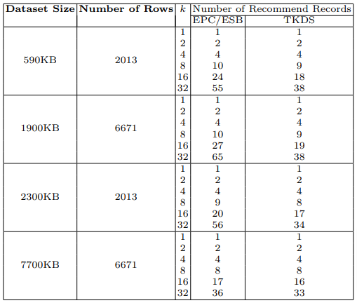
Experimental Results
Dominance
TKDS recommends unique records in response to top k query where other methods show less uniqueness.

Slide 19
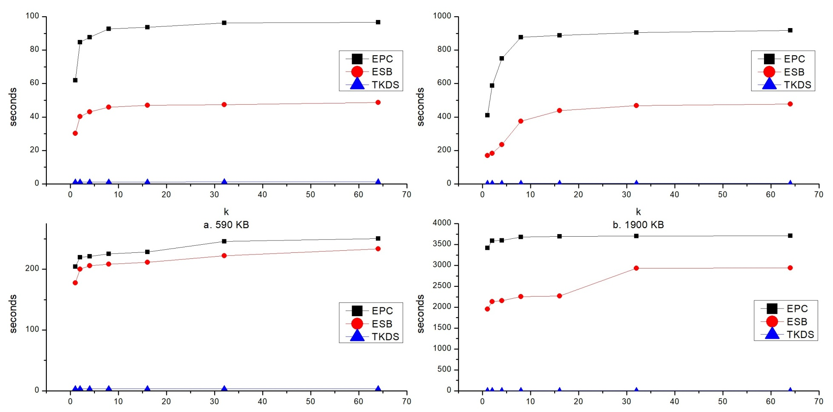
Experimental Results
Retrieval
Figure: Retrieval time comparison for real dataset

Slide 20
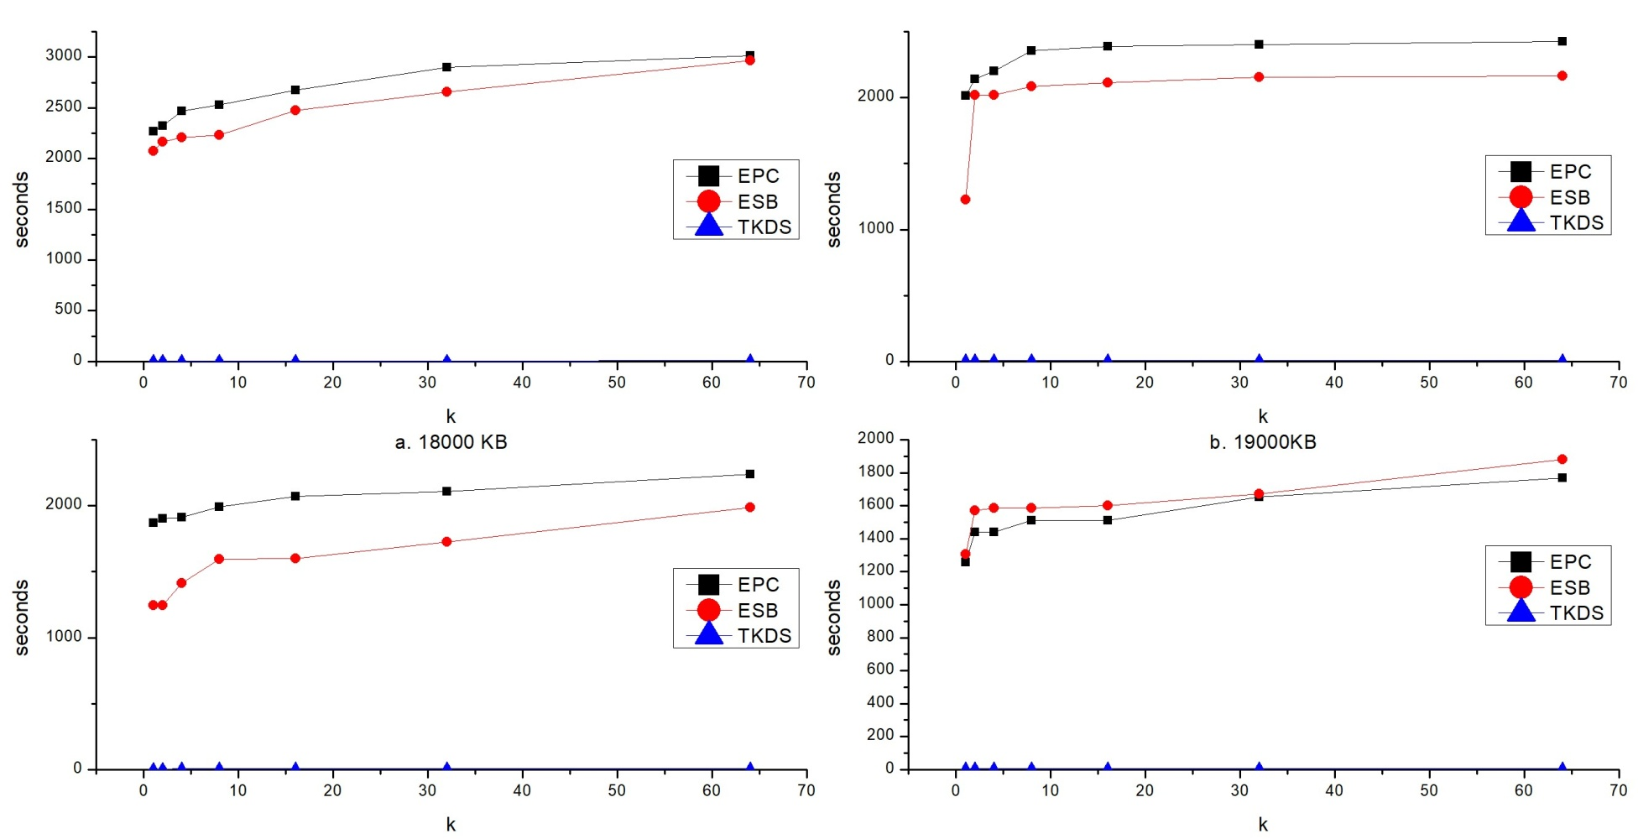
Experimental Results
Retrieval
Figure: Retrieval time comparison for synthetic dataset

Slide 21
Conclusion
We introduced a stability component so that the final result would be more justified and in line with reality
We offer a novel strategy in which a data structure known as a Compressed Data List (CDL) serves as the primary constituent of our model
Data retrieval becomes speedy having the capability to index CDL.
The proposed approach results in fewer duplicate scores and a ranking of the top k items that is more reflective for practical applications

Slide 22
Future Research Direction
Models can be implemented in parallel processing environment. Because the buckets are independent of one another, they can effectively be used in a parallel setting to handle enormous datasets.
Evaluating the model with a dataset that is significantly larger and addressing the shortcomings of the study.
Extending the study using more missing data sets and doing a more in-depth analysis of the observation are both being considered.

Slide 23
References
Miao X, Gao Y, Zheng B, Chen G, Cui H. Top-k dominating queries on incomplete data. IEEE Transactions on Knowledge and Data Engineering. 2015 Jul 24;28(1):252-66.
Papadias D, Tao Y, Fu G, Seeger B. Progressive skyline computation in database systems. ACM Transactions on Database Systems (TODS). 2005 Mar 1;30(1):41-82.
Han X, Li J, Gao H. TDEP: efficiently processing top-k dominating query on massive data. Knowledge and Information Systems. 2015 Jun;43:689-718.

Slide 24
References
4. Hasan KA, Tsuji T, Higuchi K. An efficient implementation for MOLAP basic data structure and its evaluation. InAdvances in Databases: Concepts, Systems and Applications: 12th International Conference on Database Systems for Advanced Applications, DASFAA 2007, Bangkok, Thailand, April 9-12, 2007.

Slide 25
Acknowledgement
Expressing my gratitude to Allah for always providing for my need.
Expressing my gratitude to my supervisor, Dr. K.M. Azharul Hasan, Professor, Department of Computer Science and Engineering (CSE), Khulna University of Engineering & Technology (KUET)
Extending my gratitude to the administration of Khulna University of Engineering & Technology (KUET), Khulna, for granting me the necessary permission and giving me with financial aid.

